Slide 1
Using Digital Platforms to Make
Behavioral Surveillance More Robust
Patrick Sullivan, DVM, PhD
Emory University
Rollins School of Public Health

Slide 2
How can digital platforms make behavioral surveillance more robust?
Increase coverage of non-urban areas
Allow evaluation of sampling frames for in-person surveillance studies
Allow more frequent assessments of key populations
Reach participants with diverse risk profiles

Slide 3
HIV and STI Behavioral Surveillance Systems – United States
National HIV Behavioral Surveillance System
  Funded by US CDC
  Conducted in 22 US cities/10-11K participants/cycle
  3-yearly cycle: MSM, HRH, IDU
  Core questions plus population-specific questions
  HIV testing
American Men’s Internet Survey – MSM only
  Funded by foundational funders and grants
  Conducted nationally annually
  ~10K participants/cycle
  Core questions and special topics
  Mailout specimen collection for subsets

Slide 4

American Men’s Internet Survey (AMIS)
Online sampling in four venue types:
  Gay social networking
  Gay general interest
  General social networking
  Geospatial social networking
Annual data reports summaring survey operations, HIV testing, HIV risk behaviors, substance use behaviors, and STI testing behaviors and diagnoses
Platform for collection of data on specific topics and collection of biologic specimens
Protocols, reports available at www.emoryamis.org

Slide 5
Use of Prevention Services Among Rural vs Urban MSM, 2012
1.00
0.83*
0.83*
0.72*
0.70*
0.86*
McKenney et al, 2017

Slide 6
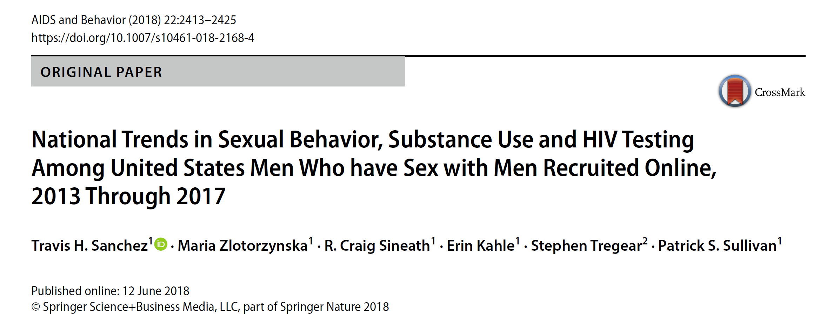

Slide 7
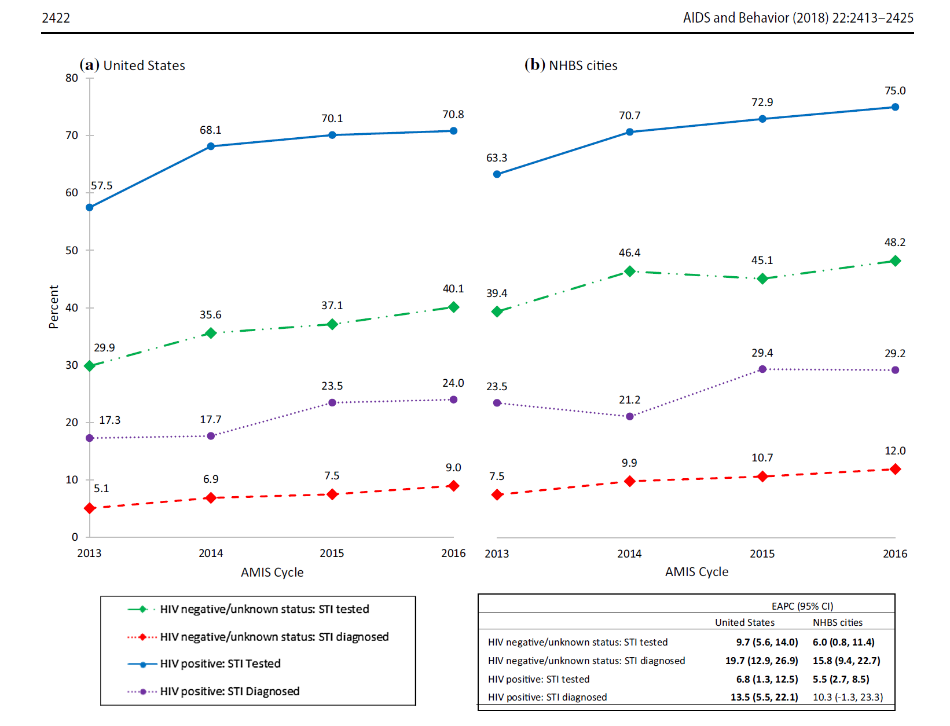

Slide 8
Evaluating sampling frames
CDC NHBS MSM cycle uses venue-time-space sampling to identify venues
Incorporates input from communities, refined each cycle in a formative evaluation process
Empiric evaluation of the sampling frame and its possible biases has been limited

Slide 9
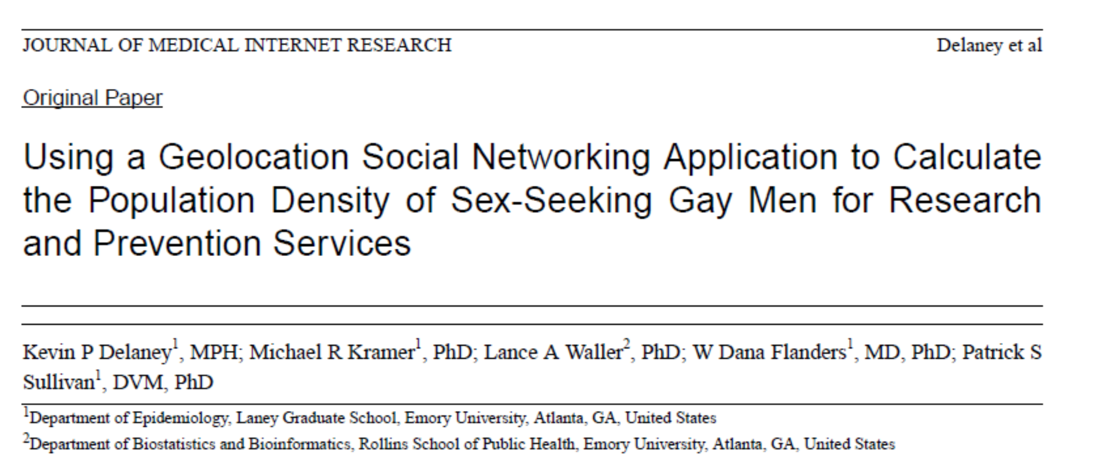
Source: J Med Internet Res 2014;16(11):e249

Slide 10
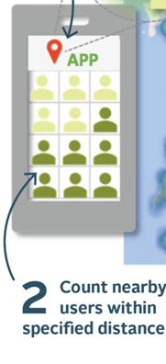

Slide 11
Source: Delaney et al, J Med Internet Res 2014;16(11):e249)

Slide 12
VBS: Place matters
Source: Delaney et al, J Med Internet Res 2014;16(11):e249)

Slide 13
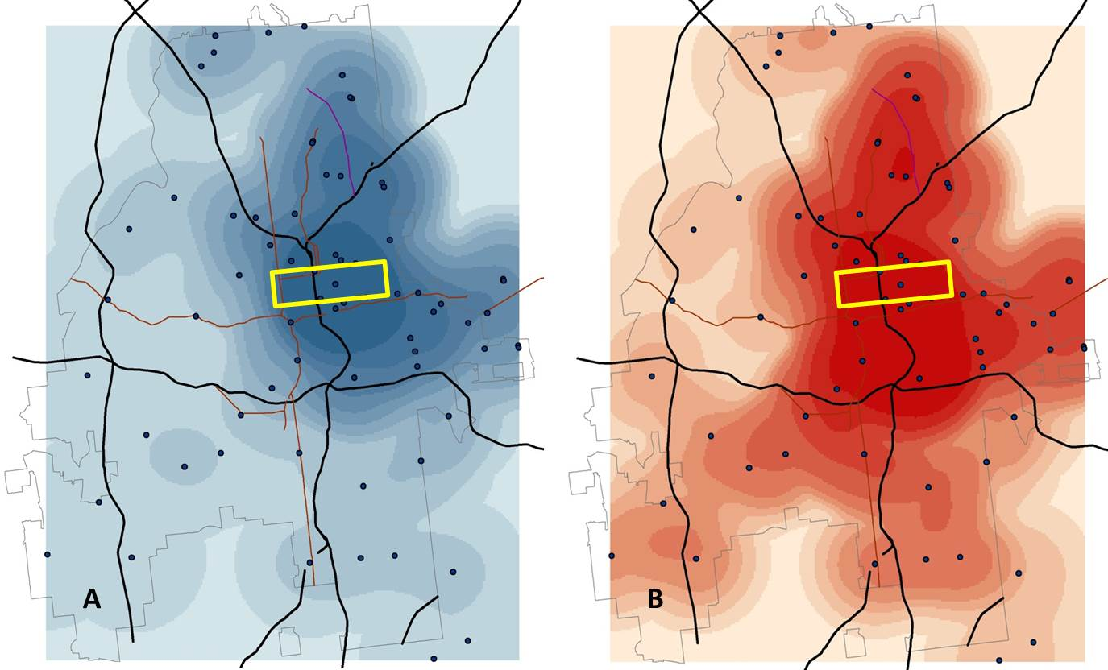
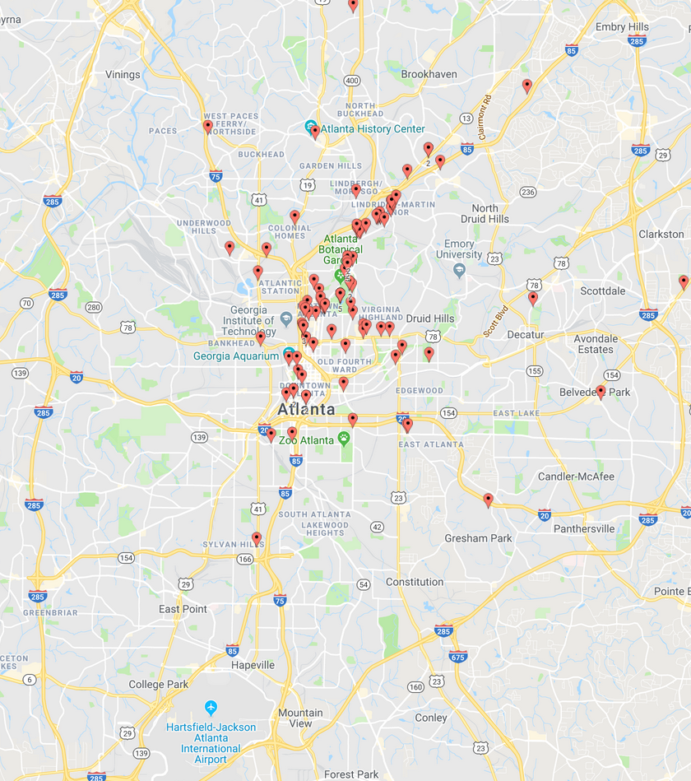
Behavioral surveillance sampling frame (A) and density of white MSM, Atlanta, 2016
A
B

Slide 14
Behavioral surveillance sampling frame (A) and density of Black MSM, Atlanta, 2016
A
B

Slide 15
Source of recruitment for MSM recruited through general social networking, general gay interest, gay social networking, and sex-seeking apps, AMIS, 2012-2016
N = 10,377
N = 9,248
N = 10,330
N = 10,217
Source: Zlotprzynska et al, JMIR Public Health Surveill 2017;3(1):e13

Slide 16
Characteristics of MSM recruited through general social networking, general gay interest, gay social networking, and sex-seeking apps, 2016
Source: Zlotprzynska et al, JMIR Public Health Surveill 2017;3(1):e13

Slide 17
How to sample MSM for HIV prevention research?
Approach | Sufficient numbers | Minimal bias | Replicable Methods | Broader geographic areas
Venue-based sampling | ++ | -- | +++ | -
Virtual Venues (sex-seeking apps) | +++ | -- | ++ | ++++
Online sampling – general social media | ++++ | ++ | + | ++++
Respondent-driven sampling | ++ | ++++ | ++++ | -

Slide 18
Summary
Behavioral surveillance systems should be continuously reassessed to address gaps in coverage and evaluate representativeness
Digital platforms allow reach to populations that can be hard to reach through in-person behavioral surveys or IBBS studies
Innovative data sources can provide opportunities for evaluation of sampling frames for venue-based recruitment studies.

Slide 19


Acknowledgements
Supported by
Travis Sanchez
Maria Zlotorzynska
PRISM Health Staff
Research Participants
NIAID
CDC
Emory CFAR
The MAC AIDS Fund
  http://www.cfar.emory.edu/services/cores/prevention
  Patrick.sullivan@emory.edu

